Slide 1

CUSTOMER RETENTION
BY Santhosh kumar Naroj

Slide 2
Introduction To Project
Customer retention is the ability of a company to retain its customers over a specified period. If a company has high customer retention, that means its customers continue to rebuy the same products, to resubscribe to the same services or, in some other way, continue buying from that company.
Customer retention is vital for two reasons: First, even if you are adding new business, you can’t grow your company if you are simultaneously losing business. The second reason is incredibly black and white: It’s always more expensive to acquire a new customer than it is to keep your current customers and sell more to them.
Customer satisfaction has emerged as one of the most important factors that guarantee the success of online store; it has been posited as a key stimulant of purchase, repurchase intentions and customer loyalty. A comprehensive review of the literature, theories and models have been carried out to propose the models for customer activation and customer retention. Five major factors that contributed to the success of an e-commerce store have been identified as: service quality, system quality, information quality, trust and net benefit.

Slide 3
Problem Statement
Customer satisfaction has emerged as one of the most important factors that guarantee the success of online store; it has been posited as a key stimulant of purchase, repurchase intentions and customer loyalty. A comprehensive review of the literature, theories and models have been carried out to propose the models for customer activation and customer retention.
Five major factors that contributed to the success of an e-commerce store have been identified as: service quality, system quality, information quality, trust and net benefit. The research furthermore investigated the factors that influence the online customers repeat purchase intention. The combination of both utilitarian value and hedonistic values are needed to affect the repeat purchase intention (loyalty) positively. The data is collected from the Indian online shoppers. Results indicate the e-retail success factors, which are very much critical for customer satisfaction.
Note:
By this have to understand to apply better analytical Insights to give findings and conclusions in detailed data.

Slide 4
DATA ANALYSIS
The Dataset Contains a 269 entries each having 71 variables, In which some are numerical Data and some are Categorical Data.
Check the info of the data using the info() function.
This is about Data set in which I makes changes in the columns to make understandable and data set having one variable is integer remaining all are categorial values.
Next Step is EDA……..(Exploratory Data Analysis)

Slide 5
EXPLORATORY DATA ANALYSIS
In EDA we need to Pre-process the Data and Visualization:
Steps include in Pre-Processing Data are :
Data Cleaning: - Removing Outliers, Skewness and imputing Missing Values.
Data Transformation: - like Normalization by applying normalization we can improve the accuracy and efficiency of the models. And also reduce the errors.
Data Reduction: - By Reducing the no of features by Feature Selection Process, PCA And VIF.
Data Cleaning: - As a Part of EDA we need to do Data cleaning so firstly we need to check any null values in our data, From the below image shows we don’t have any null values, so no need to impute any data.

Slide 6
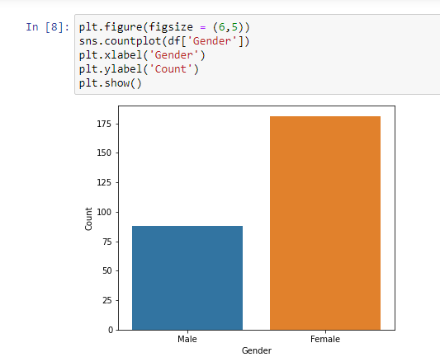
VISUALIZATION
We Analyse the variables using the count plot for categorical the variables and distribution plot for numerical variables.
Female count is more than double of male count.
Females shops more than males do as per the survey data.

Slide 7
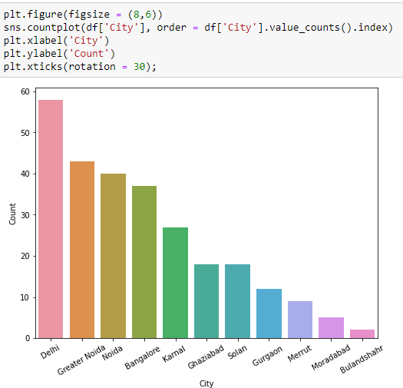
SHOPPING RATIO AS PER THE CITIES
Delhi is the city from which maximum orders placed, which is due to the lifestyle of people living in the city.
2.Greater Noida, Noida, and Banglore follows in terms of online sales.
3.Least among all is Merrut, Moradabad, Bulandshire in sales as people. In these places doesn't follow fast moving lifestyle as industries and MNC's are less in these areas, Which makes people to adapt with local lifestyle than online shopping.

Slide 8
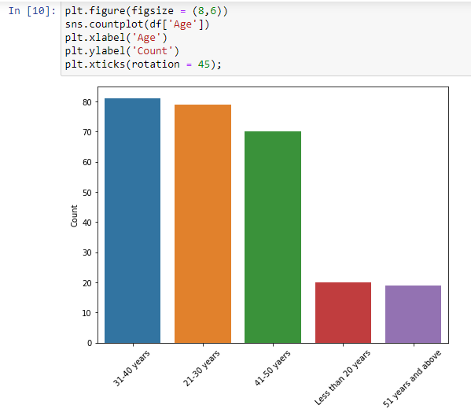
COUNT OF CUSTOMERS ACCORDING TO AGE
Highest number of customers are in range 31-40yrs.
2.However there is no great difference in sales from 21-50yrs, As this age range is the earning class and shops more.
3.Lowest number of customers are in the age range less than 20 and greater than 51yrs. Former category is majorly students and later is retired.

Slide 9
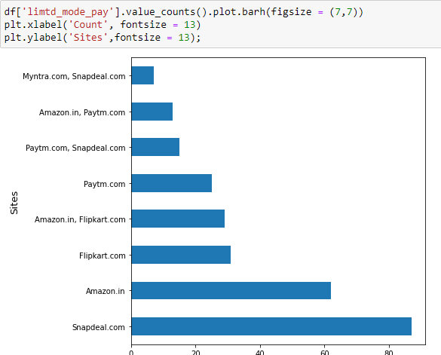
Visualizing which site has less limited mode of payment
It's clearly visualized that snapdeal has limited mode of payment.

Slide 10
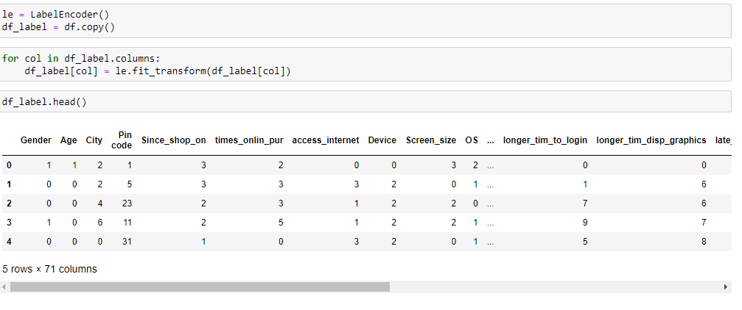
LABEL ENCODING
label encoding is necessary for the data to process find any outliers are there as of our data consists of both numerical and categorical need to change categorical into numerical values using the encoding methods.
ONE HOT ENCODING:
categorical data refers to variables that are made up of label values, for example, a “color” variable could have the values “red“, “blue, and “green”. think of values like different categories that sometimes have a natural ordering to them.

Slide 11
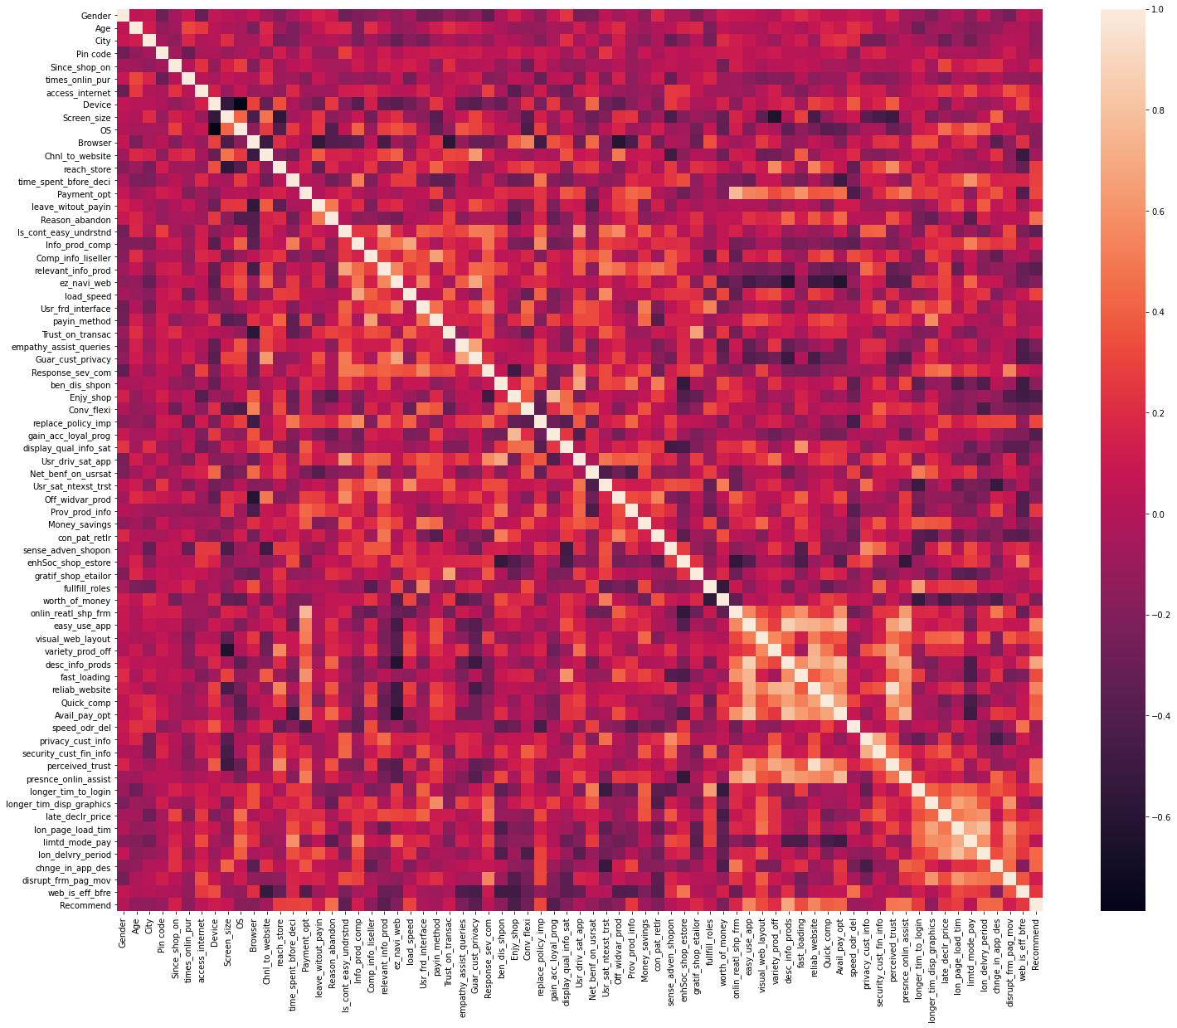

CORRELATION

Slide 12
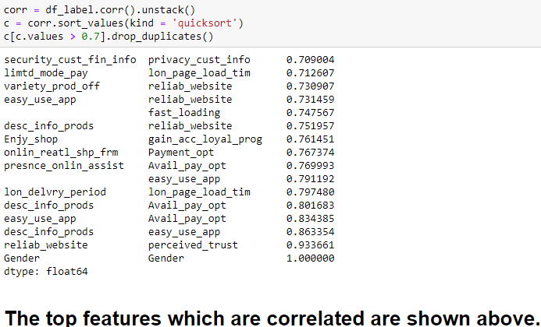
We can observe that there are many variables which have high and low correlation with other independent variables.
We have to use correlation matrix to check the relation/dependencies between the independent and target variables.
We have to remove one of the highly correlated independent variable to get rid of the problem of multicollinearity.

Slide 13
THANK YOU

